Slide 1
Java Dev Camp {girls edition}: take 2- welcome back!

Slide 2
Agenda -first 2 sessions in review-
GIT – get up to date with master
What are we developing - Advertising business model
Where are we so far - Code in review

Slide 3
GIT Review

Slide 4
Git Flow
master - production.
develop - pre-production
feature-* - new feature
hotfix-* - bug fixes
release-* - production ready new features and bug fixes that come from stable develop branch

Slide 5
Get up to date with master brach
Go to your working directory
Get latest changes from upstream
git checkout master
git pull
Create a new breanch and push it upstream
git checkout -b new_branch_name
git push --set-upstream origin new_branch_name
Open project in IntelliJ
IntelliJ ->New -> Project from Existing Sources -> pom.xml

Slide 6
The Advertising Model

Slide 7
You:
The consumer
Publisher:
The individual or business in charge of a website or app. They sell advertising space on their websites and apps to advertisers.
Advertiser:
The individual or business that has a product or service they want to advertise. They buy advertising space on websites and apps.
Third-Party Advertising Company:
Websites and apps usually do not play a direct role in choosing the ads you see. Instead, a third-party manages the ad selection and placement for both the publisher and advertiser.

Slide 8
ERD

Slide 9
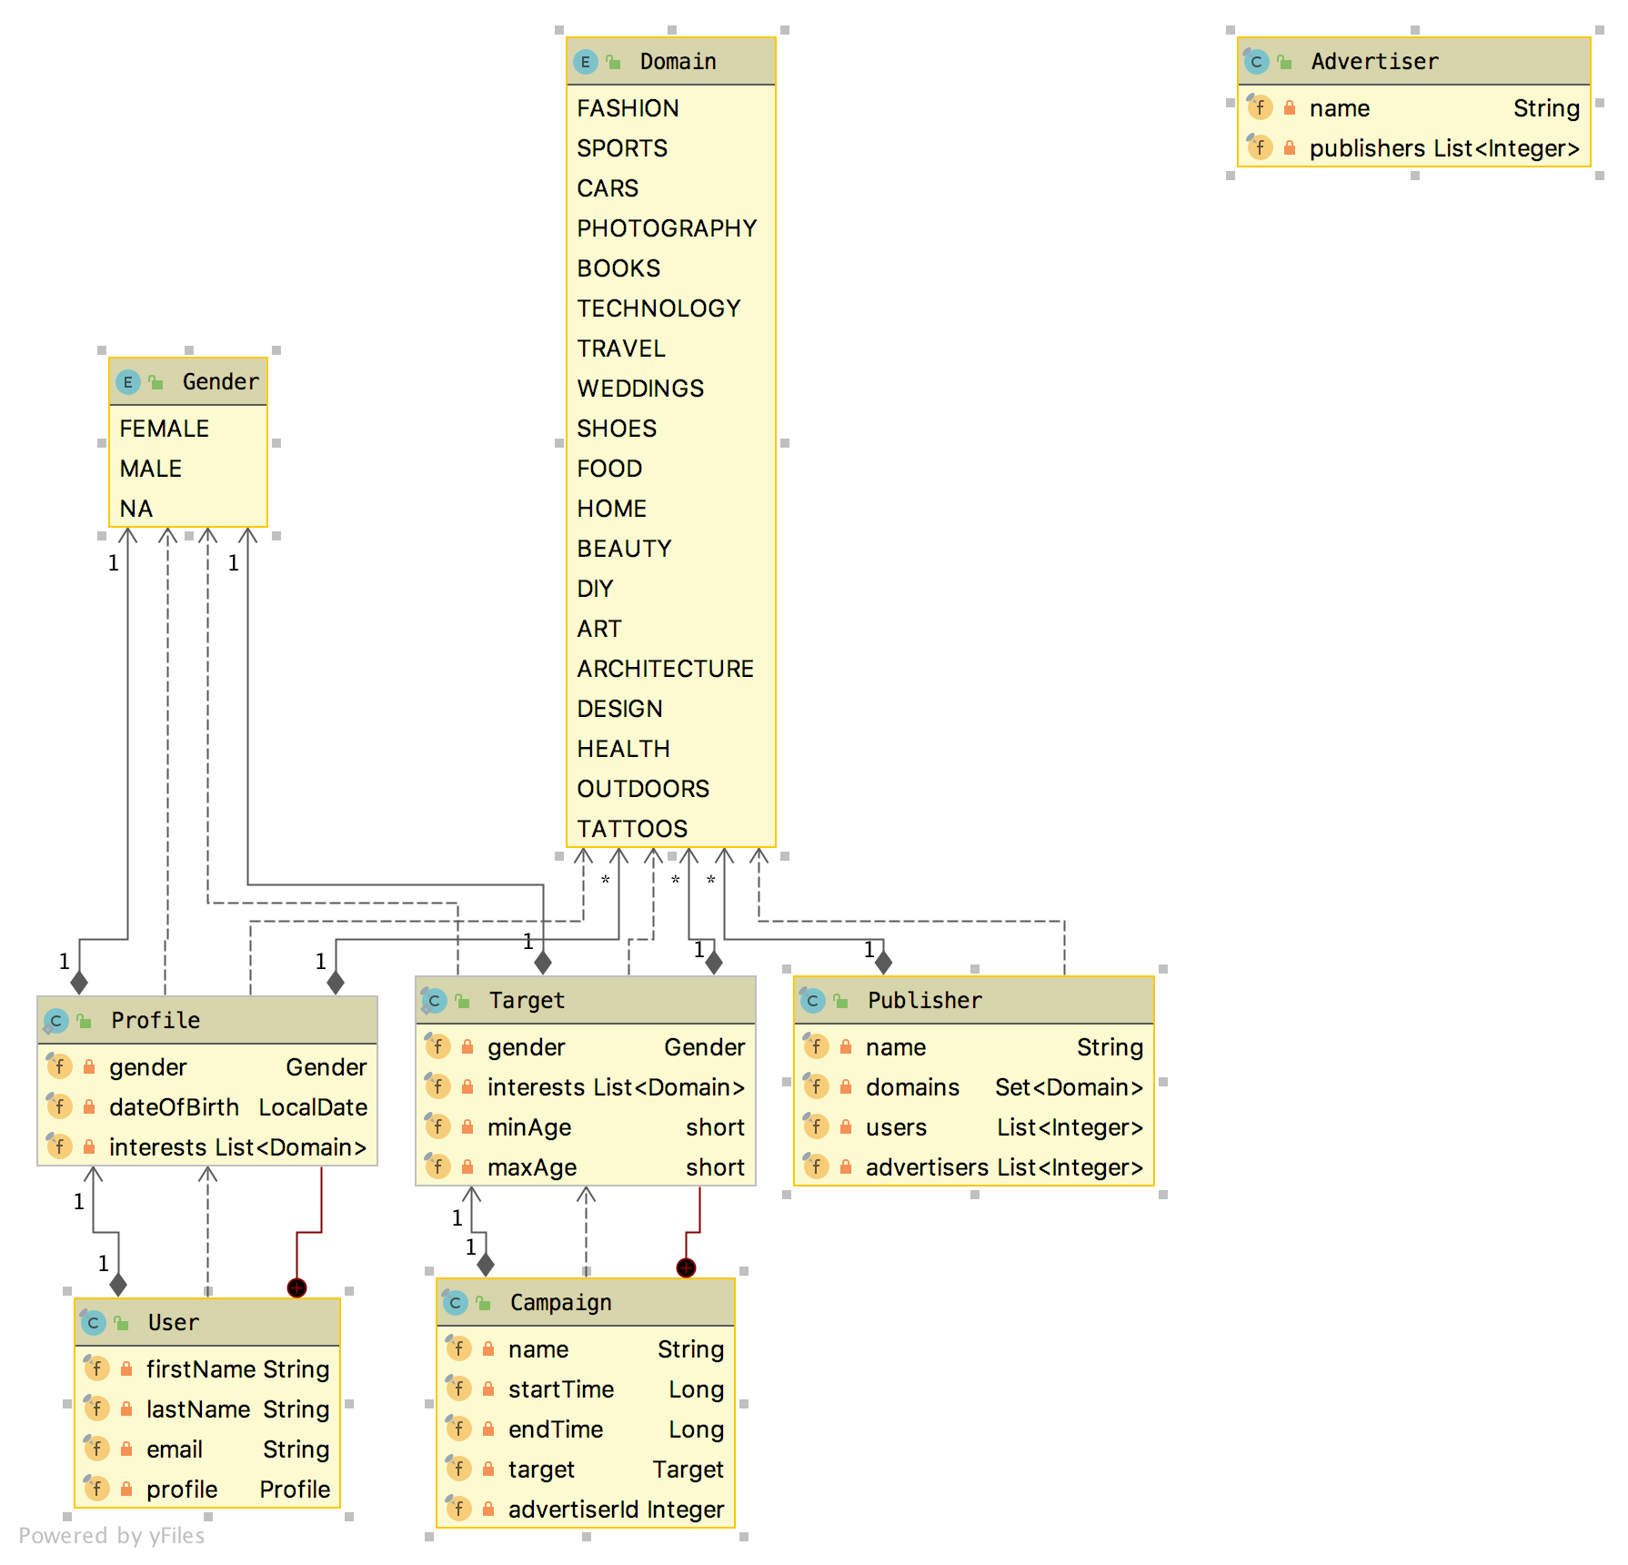

Slide 10
@SpringBootApplication where the magic happens
Class that can be used to bootstrap and launch a Spring application from a Java main method. By default class will perform the following steps to bootstrap your application:
Create an appropriate ApplicationContext instance (depending on your classpath)
Register a CommandLinePropertySource to expose command line arguments as Spring properties
Refresh the application context, loading all singleton beans
Trigger any CommandLineRunner beans
It also runs embedded Tomcat server in Spring web application.
Once started the application can be accessed at localhost:8080

Slide 11
DAO PATTERN
The Data Access Object (DAO) pattern is a structural pattern that allows us to isolate the application/business layer from the persistence layer (usually a relational database, but it could be any other persistence mechanism) using an abstract API.
The functionality of this API is to hide from the application all the complexities involved in performing CRUD operations in the underlying storage mechanism. This permits both layers to evolve separately without knowing anything about each other.
UserDAO

Slide 12
The Service Layer
The DAO layer's main goal is to handle the details of the persistence mechanism. While the service layer stands on top of it to handle business requirements.
Notice that the DAO interface will be referenced from the service
Object Mapper - serialize Java objects into JSON and deserialize JSON string into Java objects
UserService

Slide 13
MAVEN review

Slide 14
KEY concepts
POM Files
Dependencies and Repositories
Build Life Cycles, Phases and Goals
Modules

Slide 15
Understanding the project’s pom.xml files
<groupId>com.adobe.devcamp</groupId> <artifactId>AdvertisingCampaignManagement</artifactId> <packaging>pom</packaging> <version>1.0-SNAPSHOT</version> <properties> <slf4j.version>1.8.0-beta4</slf4j.version>... </properties> <modules> <module>provisioning</module> <module>app</module> </modules>
<build> <plugins> <plugin> <groupId>org.apache.maven.plugins</groupId> <artifactId>maven-compiler-plugin</artifactId> <version>3.8.1</version> <configuration> <source>1.8</source> <target>1.8</target> </configuration> </plugin> </plugins> </build> <dependencyManagement> <dependencies> <dependency> <groupId>org.slf4j</groupId> <artifactId>slf4j-api</artifactId> <version>${slf4j.version}</version> </dependency> </dependencies> </dependencyManagement> </project>

Slide 16
Build commands
Compile a project:
mvn compile
Run unit tests (it also compiles a project):
mvn test
Build a package (it also executes unit tests):
mvn package
Run integration test (it also builds a package):
mvn verify
Install a package into local repository (it also executes integration tests):
mvn install
Install an artifact into local repository (skip unit and integration test execution):
mvn -DskipTests=true install
Deploy artifact into enterprise repository:
mvn deploy

